Slide 1
Design and Analysis of Algorithms (UE20CS251)
Unit V - Backtracking and Branch-and-Bound
Mr. Channa Bankapur
channabankapur@pes.edu

Slide 2
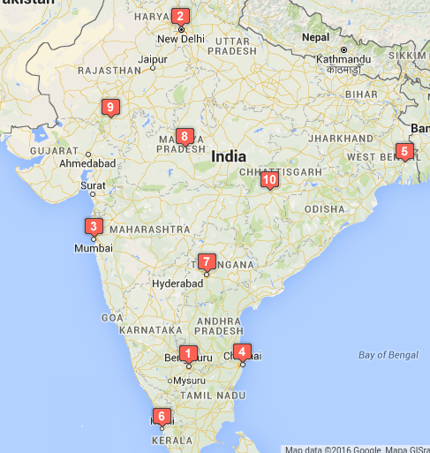
Travelling Salesman Problem:
Bengaluru
New Delhi
Mumbai
Chennai
Kolkata
Kochi
Hyderabad
Bhopal
Udaipur
Raipur

Slide 3
Travelling Salesman Problem:
Given n cities and distances between each pair of cities, find the shortest tour that passes through all other cities and returns to the origin city.
In case of a weighted complete graph, it’s about finding the shortest Hamiltonian circuit.
Eg: Driving time between some 10 cities of India (Cost Matrix).
000000 110189 050573 020948 109480 034435 028433 074836 091767 068406
109006 000000 079663 118195 079397 143304 083593 045792 037923 068146
051516 080265 000000 070149 121881 083636 044745 043763 042416 067450
021557 119539 069838 000000 095820 042397 037471 084186 111032 077756
110053 081231 121373 095977 000000 134475 085826 087690 100264 054016
034488 144238 082769 041728 134042 000000 062482 108885 123963 102455
028473 084770 045153 037117 085732 062772 000000 049417 078006 042987
075056 046162 044536 084245 086579 109354 049641 000000 031151 038399
092933 037994 042414 111566 099497 125053 078960 031010 000000 068113
068718 068844 068336 077907 055357 103016 043305 038648 068634 000000

Slide 4
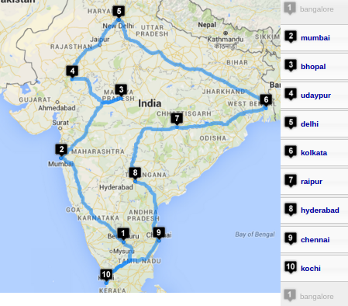
Travelling Salesman Problem:
Bengaluru
Mumbai
Bhopal
Udaipur
New Delhi
Kolkata
Raipur
Hyderabad
Chennai
Kochi
Bengaluru
Shortest round
trip takes
454201 sec.

Slide 5
Algorithm Travelling Salesperson Problem
mincost ← Infinity
for each permutation of (n - 1) cities
cost ← 0
for each edge in the Hamiltonian circuit
cost ← cost + cost of the edge
if (cost < mincost)
mincost ← cost
return mincost
Input Size: n
Basic Operation : addition of cost of an edge
C(n) = n * (n - 1)! = n! ∈ Θ(n!)

Slide 6
ALGORITHM TravellingSalesmanProblem
//Input: n x n adjacency matrix A. Assumed n > 1.
//Output: Min Cost Hamiltonian circuit.
//getPermutation(P[]) returns true with next permutation in lexicographic
// order, if it exists. Returns false otherwise.
mincost ← INFINITY
Permutation[1..n-1] ← [1, 2, 3, …, n-1] //1st permutation
do
cost ← A[0, Permutation[1]] //1st edge of the circuit
for i ← 1 to n-2
cost ← cost + A[Permutation[i], Permutation[i+1]]
cost ← cost + A[Permutation[n-1], 0] //last edge
if (cost < mincost) mincost ← cost
while(getNextPermutation(Permutation[1..n-1]))
return mincost

Slide 7
Travelling Salesman Problem:
Example:
Graph vertices: A, B, C, D
0 6 5 2
1 0 3 -
5 3 0 3
2 2 7 0

Slide 8
Backtracking
The exhaustive search technique suggests generating all candidate solutions and then identifying the one (or the ones) with a desired property.
Construct solutions one component at a time and evaluate such partially constructed candidates.
Construct the state-space tree
non-leaf nodes: promising nodes with partial solutions
leaves: non-promising nodes or solutions
edges: choices in extending partial solutions
Explore the state space tree using depth-first search.
Backtrack at non-promising nodes.

Slide 9
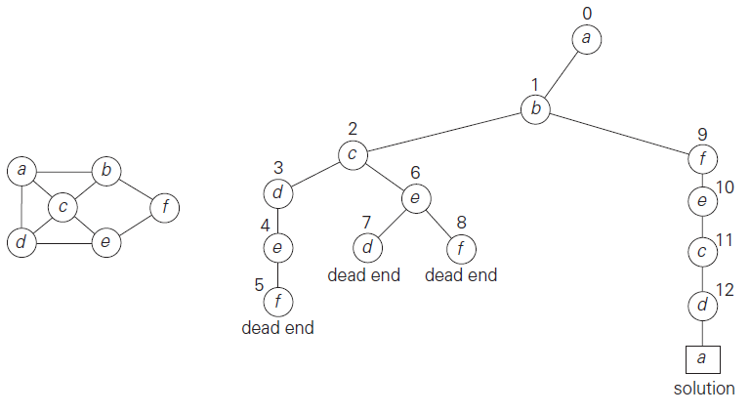
Backtracking - Hamiltonian Circuit Problem

Slide 10
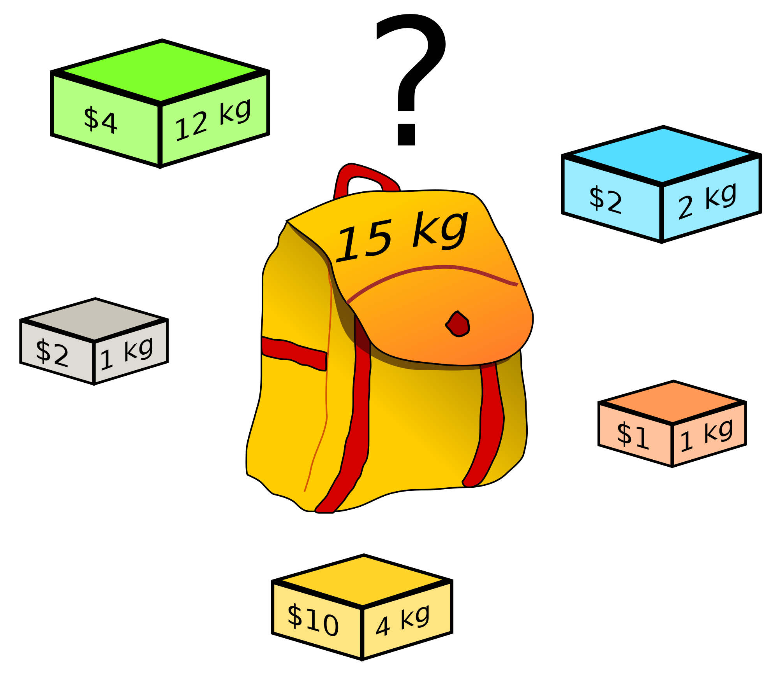
Knapsack Problem:
Given n items:
weights: w₁ w₂ … w_{n}
values: v₁ v₂ … v_{n}
a knapsack of capacity W
Find most valuable subset of the items that fit into the knapsack.

Slide 11
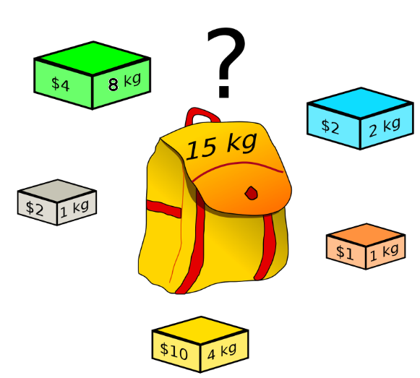
Knapsack Problem:
Given n items:
weights: w₁ w₂ … w_{n}
values: v₁ v₂ … v_{n}
a knapsack of capacity W
Find most valuable subset
of the items that fit into the knapsack.
Ans: {B,O,Y,W} 8kg, $15
What if the green object weighs 8 kg instead of 12 kg?

Slide 12
Knapsack Problem:
What if the green object weighs 8 kg instead of 12 kg?
Ans:
{G,B,Y,W}
15kg, $18

Slide 13
Example:
Knapsack capacity W=16
item weight value
1 2 $20
2 5 $30
3 10 $50
4 5 $10
{2,3} with value $80 is optimal.
C(n) ∈ 𝛀(2^{n})
Subset Total weight Total value
{} 0 $0
{1} 2 $20
{2} 5 $30
{3} 10 $50
{4} 5 $10
{1,2} 7 $50
{1,3} 12 $70
{1,4} 7 $30
{2,3} 15 $80
{2,4} 10 $40
{3,4} 15 $60
{1,2,3} 17 -
{1,2,4} 12 $60
{1,3,4} 17 -
{2,3,4} 20 -
{1,2,3,4} 22 -

Slide 14
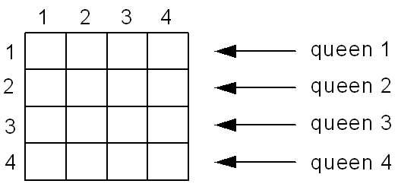
Backtracking - n-Queens Problem
Place n queens on an n-by-n chessboard so that no two of them are in the same row, column, or diagonal.

Slide 15
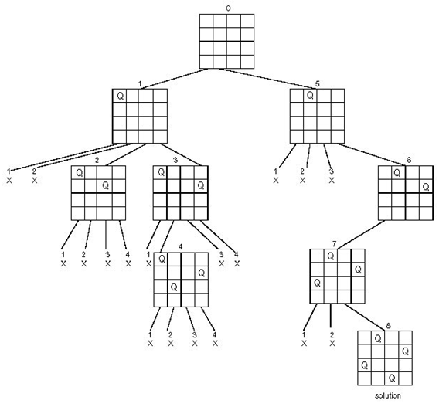
Backtracking - n-Queens Problem

Slide 16
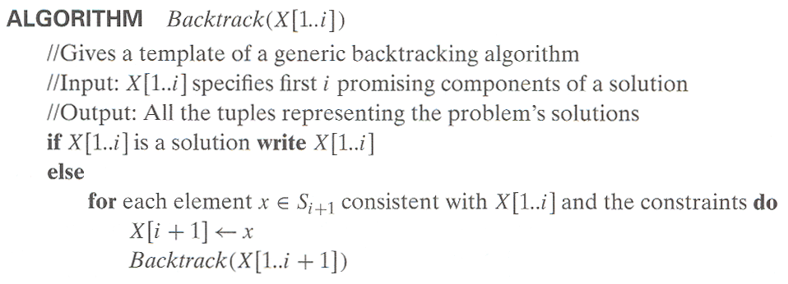
Backtracking - template algorithm

Slide 17
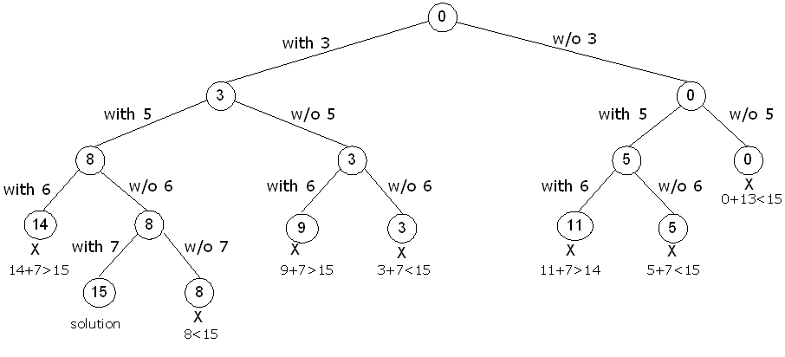
Backtracking - Subset-Sum Problem
S = {3, 5, 6, 7} and d = 15

Slide 18
Branch-and-Bound
An enhancement of backtracking
Applicable to optimization problems
Makes a note of the best solution seen so far
For each node (partial solution) of the state-space tree, computes a bound on the value of the objective function for all descendants of the node (extensions of the partial solution)

Slide 19
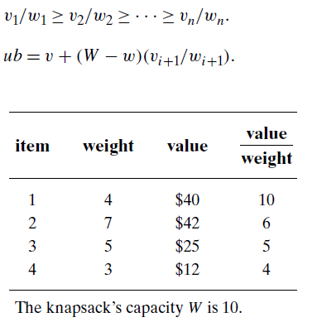
Branch-and-Bound - Knapsack Problem

Slide 20
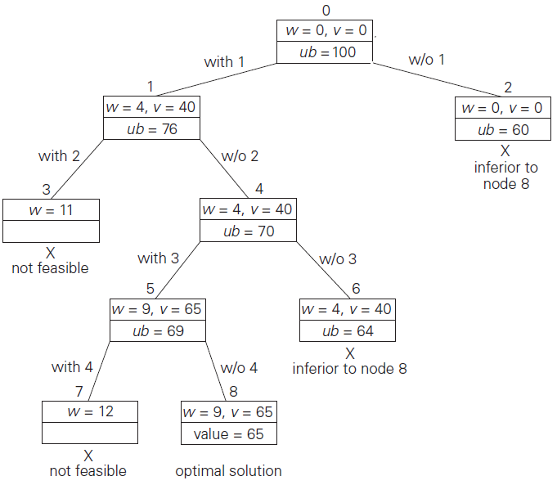
Branch-and-Bound -
Knapsack Problem

Slide 21
Branch-and-Bound - Knapsack Problem
Example:
Knapsack capacity W=16
item weight value
1 2 $20
2 5 $30
3 10 $50
4 5 $10

Slide 22
Branch-and-Bound - Travelling Salesman Problem
Objective is to minimize the cost of the circuit. The effort of minimizing does not help if the lower bound is already higher than a solution found so far at an intermediate stage.
Example:
Graph vertices: A, B, C, D
0 6 5 2
1 0 3 -
5 3 0 3
2 2 7 0

Slide 23
Branch-and-Bound - Travelling Salesman Problem
One very simple lower bound can be obtained by finding the smallest element in the intercity distance matrix D and multiplying it by the number of cities n.
Lower bound = n * (cost of the least cost edge)
A better method is for each city i, 1≤ i ≤ n, find the sum s_{i} of the distances from city i to the two nearest cities; compute the sum s of these n numbers, divide the result by 2
Lower bound = ceil( s/2 )

Slide 24
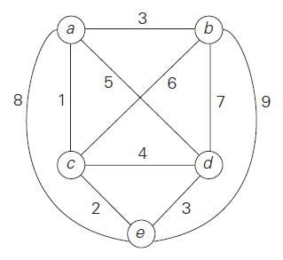
Branch-and-Bound - Travelling Salesman Problem
Initial lower bound =
ceil( ( (1 + 3) + (3 + 6) + (1 + 2) +
(3 + 4) + (2 + 3) ) / 2 ) = 14.
Lower bound for all the
Hamiltonian circuits of the graph
that must include edge (a, d) =
ceil( ( (1 + 5) + (3 + 6) + (1 + 2) +
(5 + 3) + (2 + 3) ) / 2 ) = 16.

Slide 25
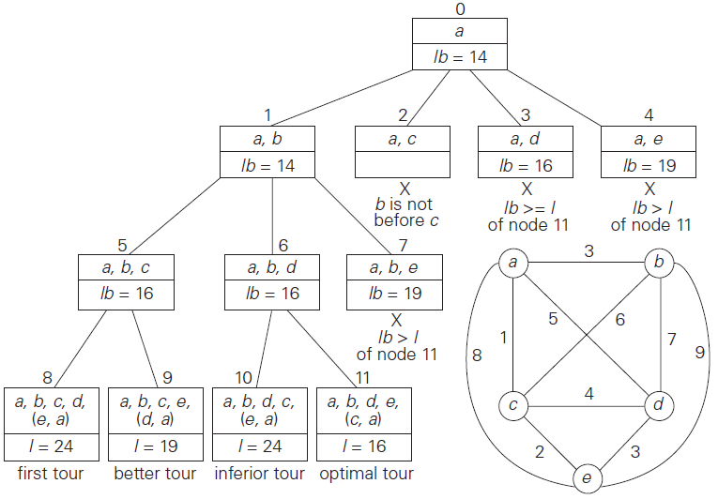
Branch-and-Bound -
Travelling Salesman Problem

Slide 26
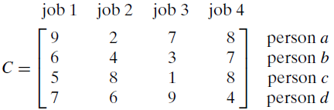
Branch-and-Bound - Assignment Problem
Objective is to minimize the cost of the assignment. The effort of minimizing does not help if the lower bound is already higher than a solution found so far at an intermediate stage.

Slide 27
Deadend? Backtrack. Repeat!
</
Backtracking
>

